Slide 1

On Two Pincer Search Algorithms Guaranteeing Capturing Evaders In Circular Area
Hay Elmaliah and Yonatan Kahalani

Slide 2
Preface
This paper deals with a resource allocation problem.
Our agents are trying to capture smart evaders located in a circular area; however, they have limited capabilities mainly their visibility.
We present two algorithms to catch the evaders while supplying theoretical foundations, and beautiful simulations.

Slide 3
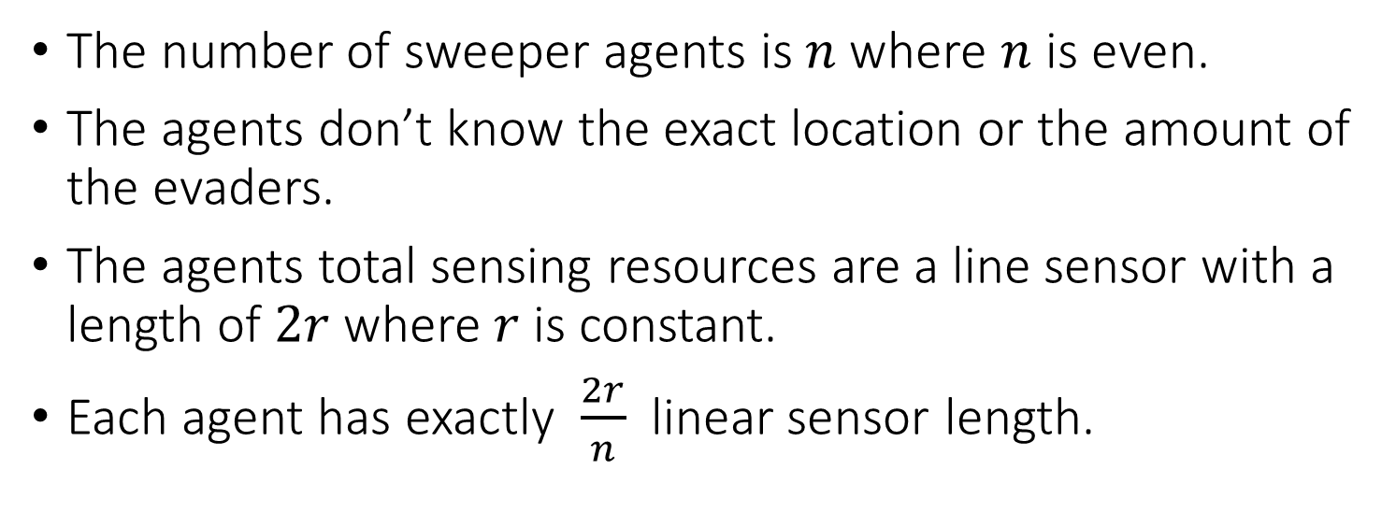
Assumptions on the Sweepers
The number of sweeper agents is $n$where $n$ is even.
The agents don’t know the exact location or the amount of the evaders.
The agents total sensing resources are a line sensor with a length of $2r$where $r$is constant.
Each agent has exactly $\frac{2r}{n}$ linear sensor length.

Slide 4
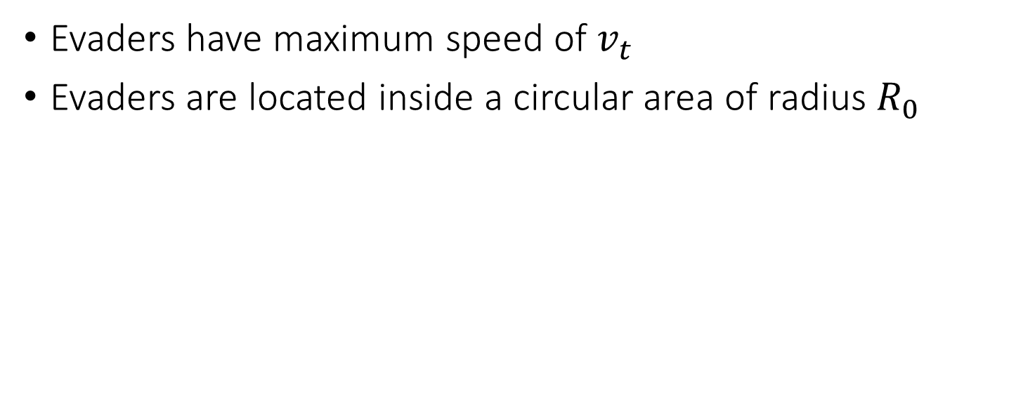
Assumptions on the Evaders
Evaders have maximum speed of $v_{t}$
Evaders are located inside a circular area of radius $R_{0}$

Slide 5
Assumptions of the model
When evaders enter the sensibility range of a sweeper agent they get caught.

Slide 6
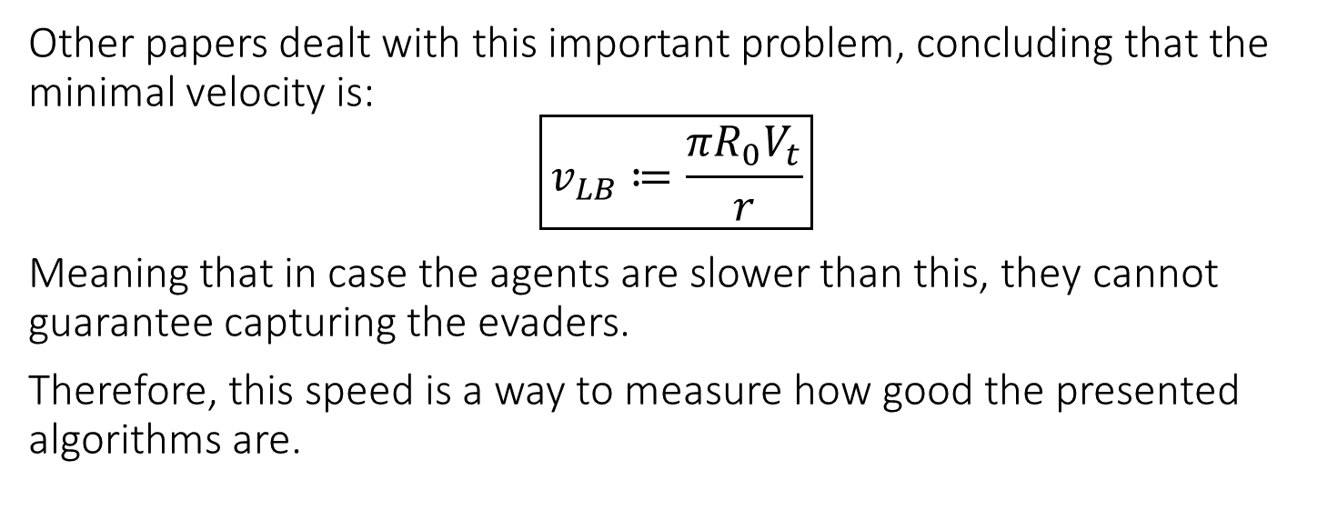
Lower bound on the velocity of the agents
Other papers dealt with this important problem, concluding that the minimal velocity is:
$$\boxed{v_{LB}≔\frac{πR_{0}V_{t}}{r}}$$
Meaning that in case the agents are slower than this, they cannot guarantee capturing the evaders.
Therefore, this speed is a way to measure how good the presented algorithms are.

Slide 7
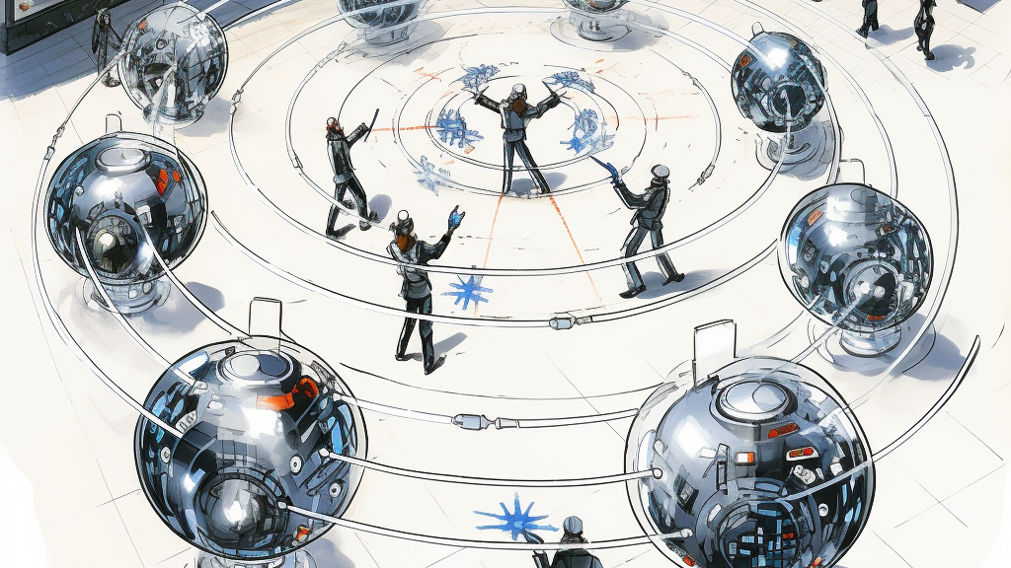
Circular Pincer Sweep with limited sensing capabilities
Algorithm 1

Slide 8
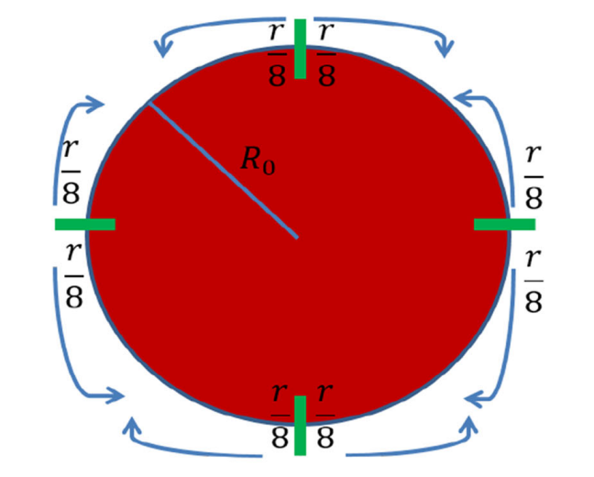
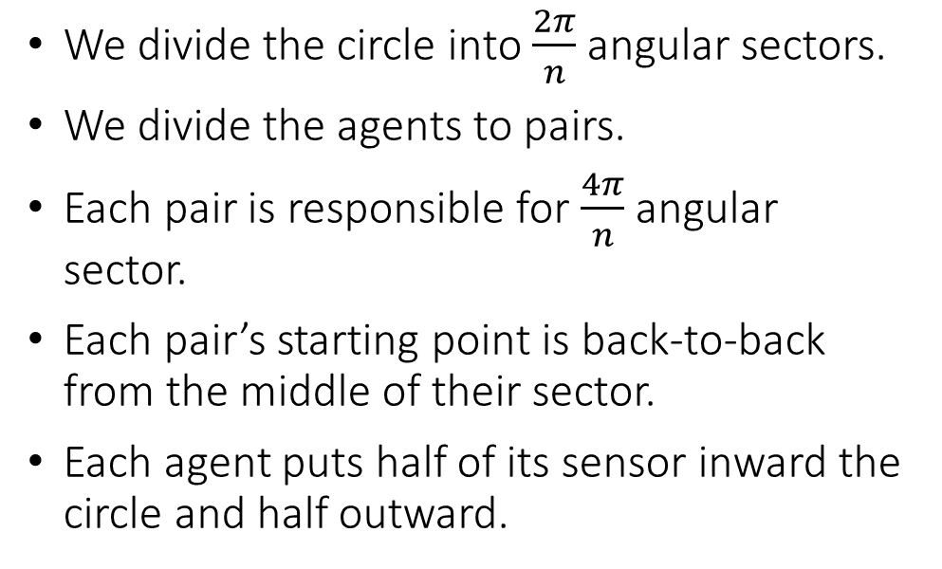
Setting of the first algorithm
We divide the circle into $\frac{2π}{n}$ angular sectors.
We divide the agents to pairs.
Each pair is responsible for $\frac{4π}{n}$angular sector.
Each pair’s starting point is back-to-back from the middle of their sector.
Each agent puts half of its sensor inward the circle and half outward.

Slide 9
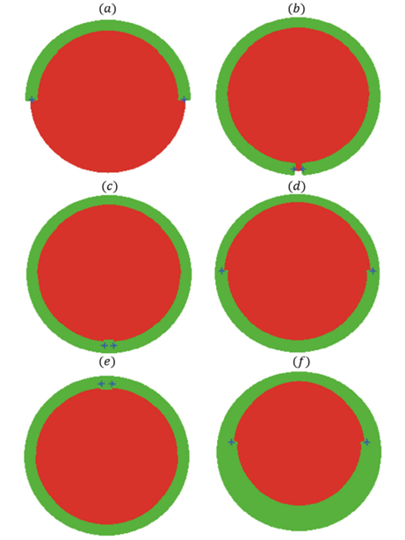
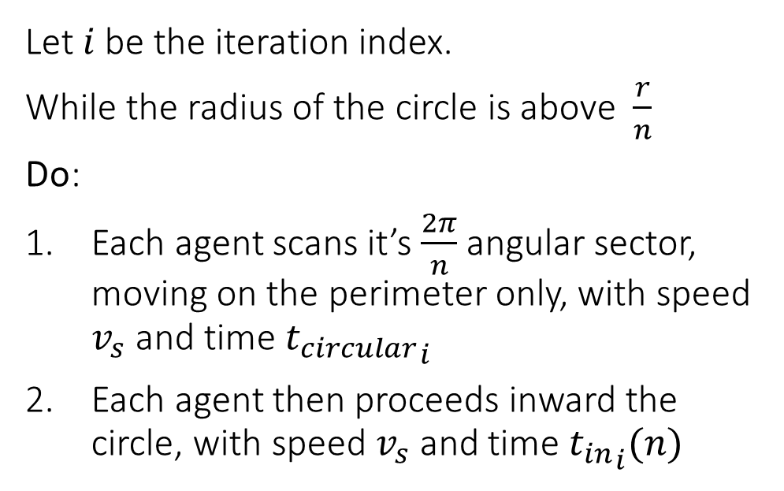
Running of the algorithm
Let $i$ be the iteration index.
While the radius of the circle is above $\frac{r}{n}$
Do:
Each agent scans it’s $\frac{2π}{n}$ angular sector, moving on the perimeter only, with speed $v_{s}$ and time ${t_{circular}}_{i}$
Each agent then proceeds inward the circle, with speed $v_{s}$and time ${t_{in}}_{i}(n)$

Slide 10
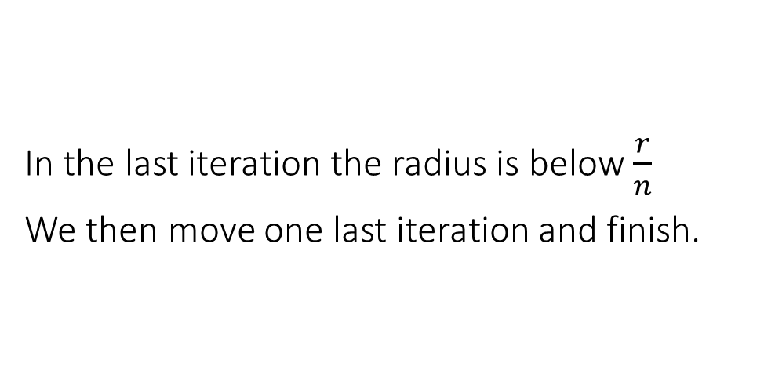
End of the algorithm
In the last iteration the radius is below $\frac{r}{n}$
We then move one last iteration and finish.

Slide 11
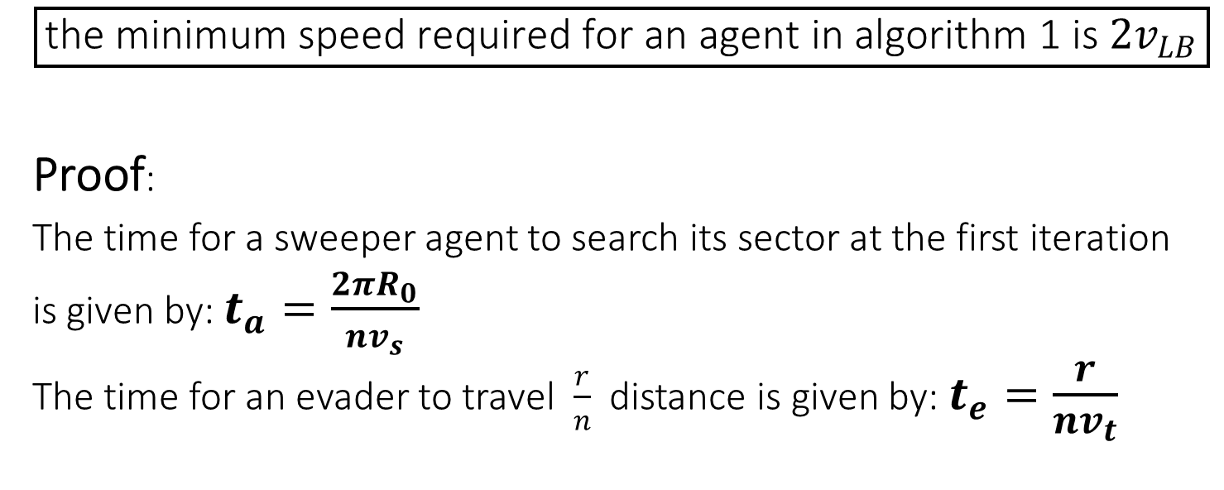
Theorem 1
$$\boxed{\text{the} \text{minimum} \text{speed} \text{required} \text{for} \text{an} \text{agent} \text{in} \text{algorithm}\text{ 1 }\text{is} 2v_{LB}}$$
Proof:
The time for a sweeper agent to search its sector at the first iteration
is given by: $t_{a}=\frac{2πR_{0}}{nv_{s}}$
The time for an evader to travel $\frac{r}{n}$ distance is given by: $t_{e}=\frac{r}{nv_{t}}$

Slide 12
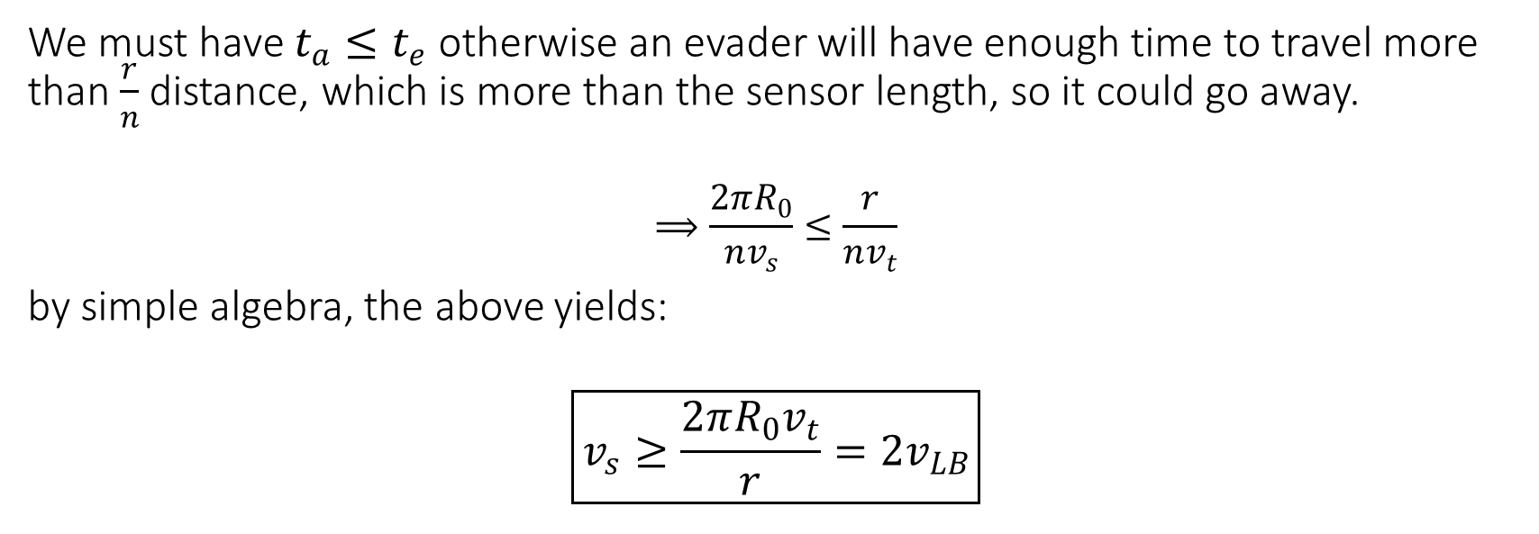
Proof - continue
We must have $t_{a}≤t_{e}$ otherwise an evader will have enough time to travel more than $\frac{r}{n}$ distance, which is more than the sensor length, so it could go away.
$$⟹\frac{2πR_{0}}{nv_{s}}≤\frac{r}{nv_{t}}$$
by simple algebra, the above yields:
$$\boxed{v_{s}≥\frac{2πR_{0}v_{t}}{r}=2v_{LB}}$$

Slide 13
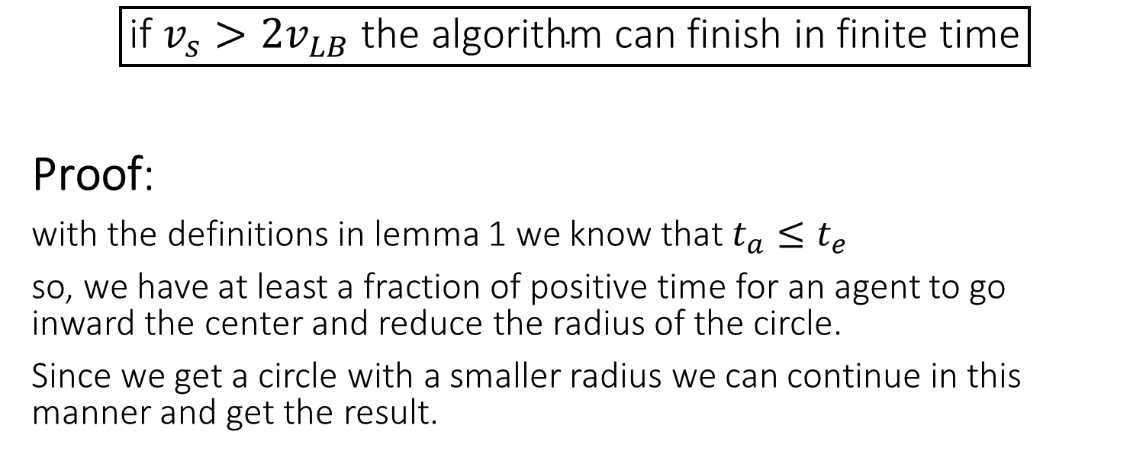
Theorem 2
$$\boxed{\text{if} v_{s}>2v_{LB} \text{the} \text{algorithm} \text{can} \text{finish} \text{in} \text{finite} \text{time}}$$
Proof:
with the definitions in lemma 1 we know that $t_{a}≤t_{e}$
so, we have at least a fraction of positive time for an agent to go inward the center and reduce the radius of the circle.
Since we get a circle with a smaller radius we can continue in this manner and get the result.

Slide 14
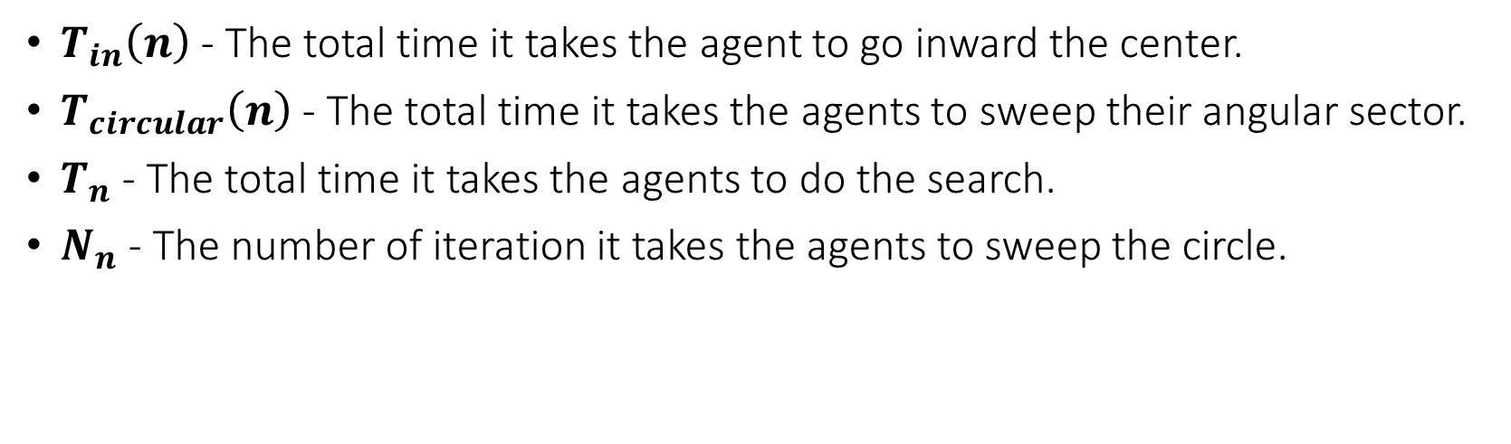
Now that we know that our algorithm works, we can calculate some specifics:
$T_{in}\left(n\right)$ - The total time it takes the agent to go inward the center.
$T_{circular}\left(n\right)$ - The total time it takes the agents to sweep their angular sector.
$T_{n}$ - The total time it takes the agents to do the search.
$N_{n}$ - The number of iteration it takes the agents to sweep the circle.

Slide 15
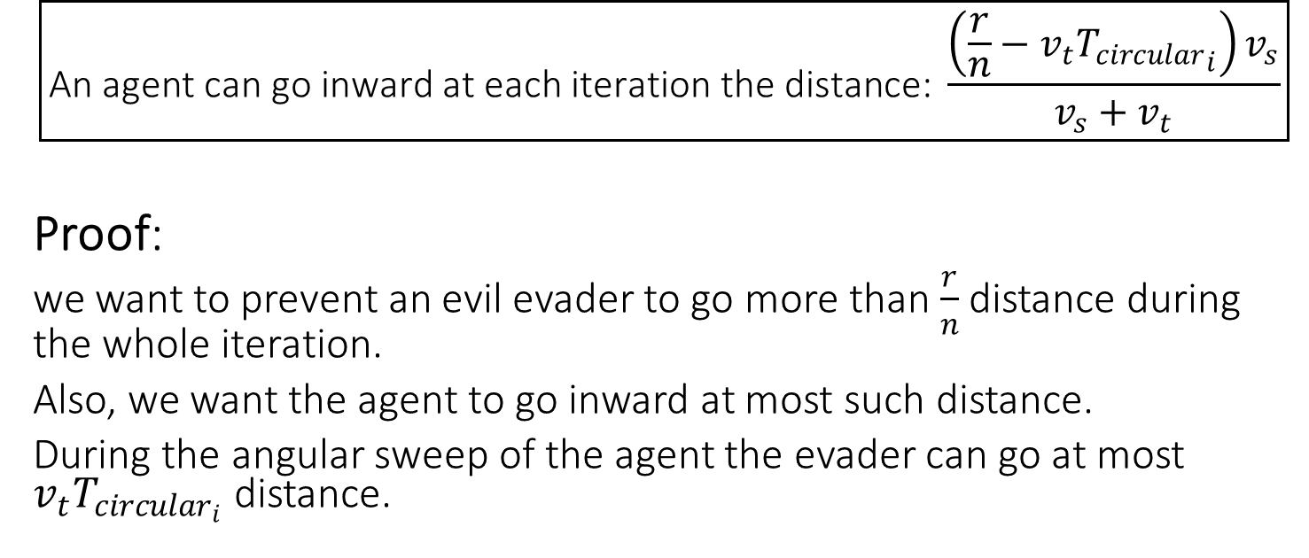
Lemma 3
$$\boxed{\text{A}\text{n} \text{agent} \text{can} \text{go} \text{inward} \text{at} \text{each} \text{iteration} \text{the} \text{distance}\text{:} \frac{\left(\frac{r}{n}−v_{t}{T_{circular}}_{i}\right)v_{s}}{v_{s}+v_{t}}}$$
Proof:
we want to prevent an evil evader to go more than $\frac{r}{n}$ distance during the whole iteration.
Also, we want the agent to go inward at most such distance.
During the angular sweep of the agent the evader can go at most $v_{t}T_{circular_{i}}$ distance.

Slide 16
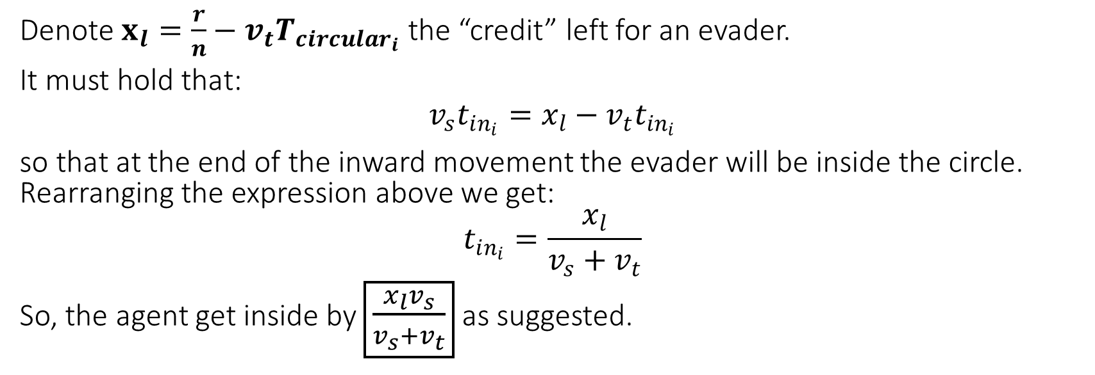
Proof - continue
Denote $x_{l}=\frac{r}{n}−$ $v_{t}T_{circular_{i}}$ the “credit” left for an evader.
It must hold that:
$$v_{s}t_{in_{i}}=x_{l}−v_{t}t_{in_{i}}$$
so that at the end of the inward movement the evader will be inside the circle. Rearranging the expression above we get:
$$t_{in_{i}}=\frac{x_{l}}{v_{s}+v_{t}}$$
So, the agent get inside by $\boxed{\frac{x_{l}v_{s}}{v_{s}+v_{t}}}$ as suggested.

Slide 17
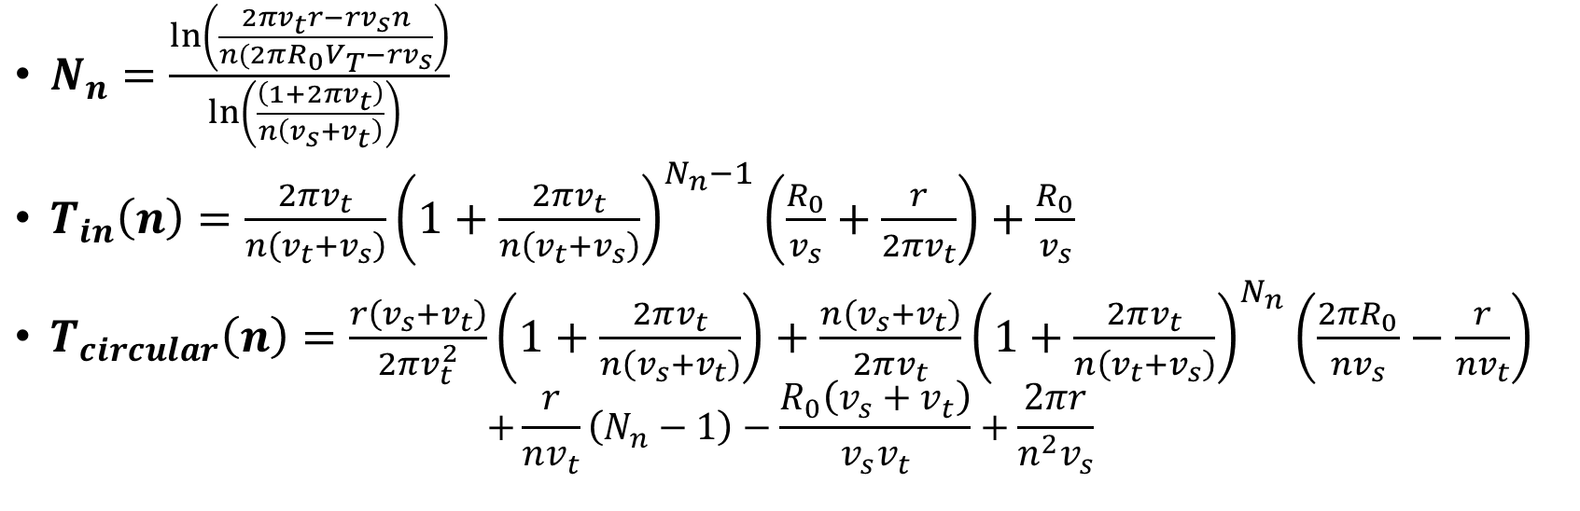
From lemma 3 we conclude the following theorem:
$N_{n}=\frac{\ln\left(\frac{2πv_{t}r−rv_{s}n}{n(2πR_{0}V_{T}−rv_{s}}\right)}{\ln\left(\frac{\left(1+2πv_{t}\right)}{n\left(v_{s}+v_{t}\right)}\right) }$
$T_{in}\left(n\right)=\frac{2πv_{t}}{n\left(v_{t}+v_{s}\right)}{\left(1+\frac{2πv_{t}}{n\left(v_{t}+v_{s}\right)}\right)}^{N_{n}−1}\left(\frac{R_{0}}{v_{s}}+\frac{r}{2πv_{t}}\right)+\frac{R_{0}}{v_{s}}$
$T_{circular}\left(n\right)=\frac{r\left(v_{s}+v_{t}\right)}{2πv_{t}^{2}}\left(1+\frac{2πv_{t}}{n\left(v_{s}+v_{t}\right)}\right)+\frac{n\left(v_{s}+v_{t}\right)}{2πv_{t}}{\left(1+\frac{2πv_{t}}{n\left(v_{t}+v_{s}\right)}\right)}^{N_{n}}\left(\frac{2πR_{0}}{nv_{s}}−\frac{r}{nv_{t}}\right)$
$$+\frac{r}{nv_{t}}\left(N_{n}−1\right)−\frac{R_{0}\left(v_{s}+v_{t}\right)}{v_{s}v_{t}}+\frac{2πr}{n^{2}v_{s}}$$

Slide 18
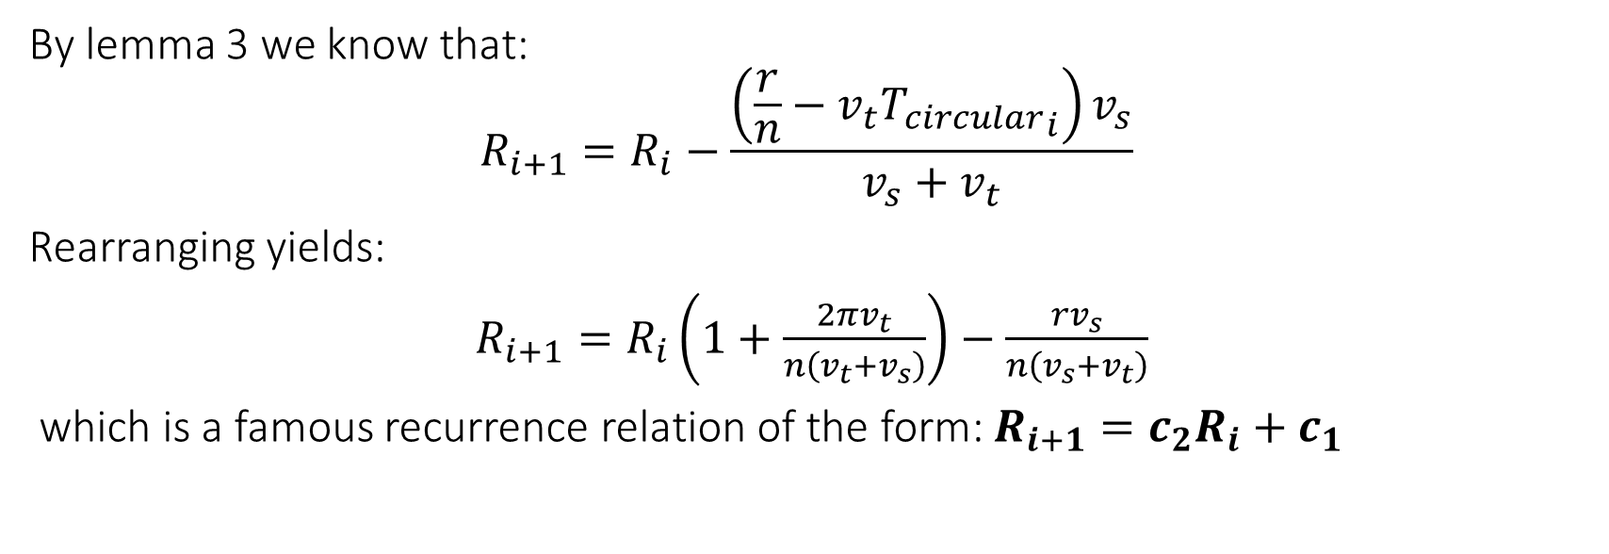
Proof
By lemma 3 we know that:
$$R_{i+1}=R_{i}−\frac{\left(\frac{r}{n}−v_{t}{T_{circular}}_{i}\right)v_{s}}{v_{s}+v_{t}}$$
Rearranging yields:
$R_{i+1}=R_{i}\left(1+\frac{2πv_{t}}{n\left(v_{t}+v_{s}\right)}\right)−\frac{rv_{s}}{n\left(v_{s}+v_{t}\right)}$
which is a famous recurrence relation of the form: $R_{i+1}=c_{2}R_{i}+c_{1}$

Slide 19
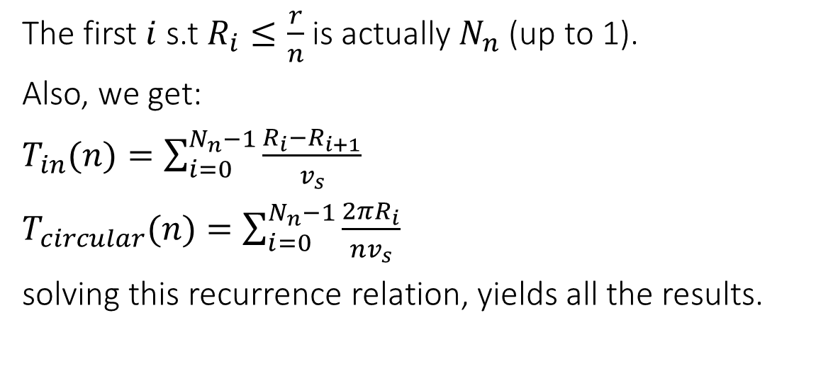
Proof - continue
The first $i$ s.t $R_{i}≤\frac{r}{n}$ is actually $N_{n}$ (up to 1).
Also, we get:
$T_{in}(n)=\sum_{i=0}^{N_{n}−1}{\frac{R_{i}−R_{i+1}}{v_{s}}}$
$T_{circular}(n)=\sum_{i=0}^{N_{n}−1}{\frac{2πR_{i}}{nv_{s}}}$
solving this recurrence relation, yields all the results.

Slide 20
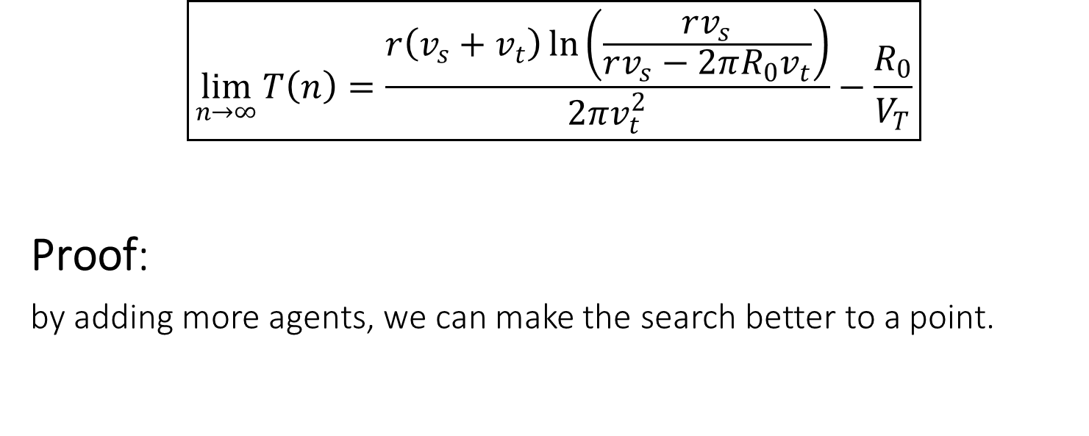
Lemma 4
$$\boxed{\lim_{n→∞}{T\left(n\right)=\frac{r\left(v_{s}+v_{t}\right)\ln\left(\frac{rv_{s}}{rv_{s}−2πR_{0}v_{t}}\right)}{2πv_{t}^{2}}−\frac{R_{0}}{V_{T}}}}$$
Proof:
by adding more agents, we can make the search better to a point.

Slide 21
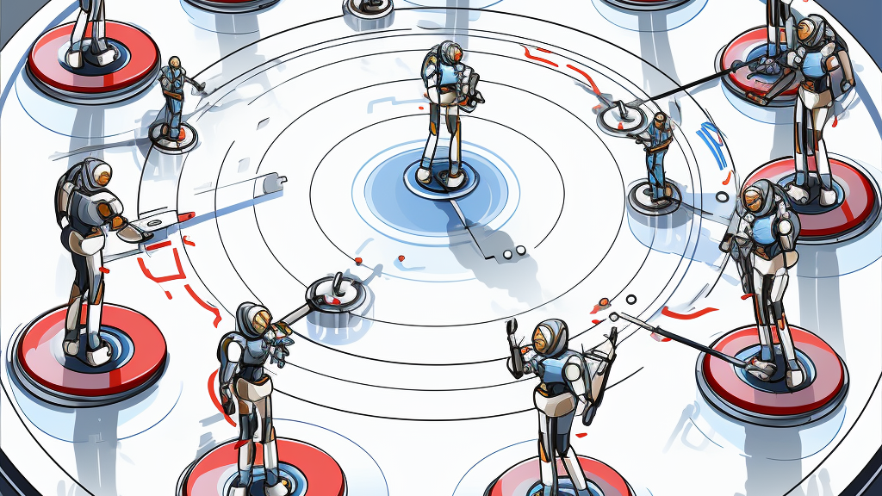
Simulation

Slide 22

Spiral Pincer Sweep with limited sensing capabilities
Algorithm 2

Slide 23
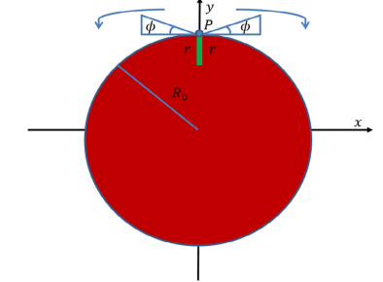
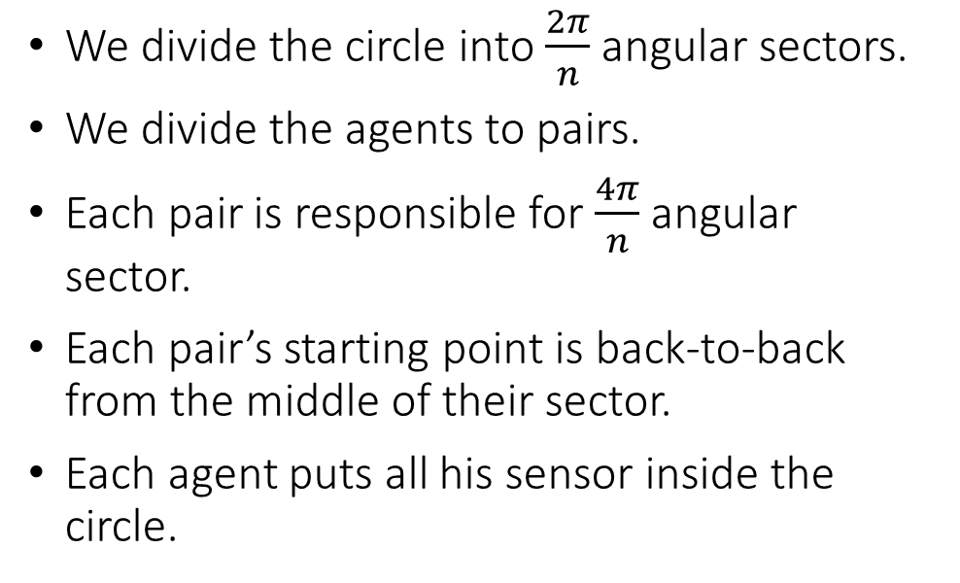
Setting of the second algorithm
We divide the circle into $\frac{2π}{n}$ angular sectors.
We divide the agents to pairs.
Each pair is responsible for $\frac{4π}{n}$angular sector.
Each pair’s starting point is back-to-back from the middle of their sector.
Each agent puts all his sensor inside the circle.

Slide 24
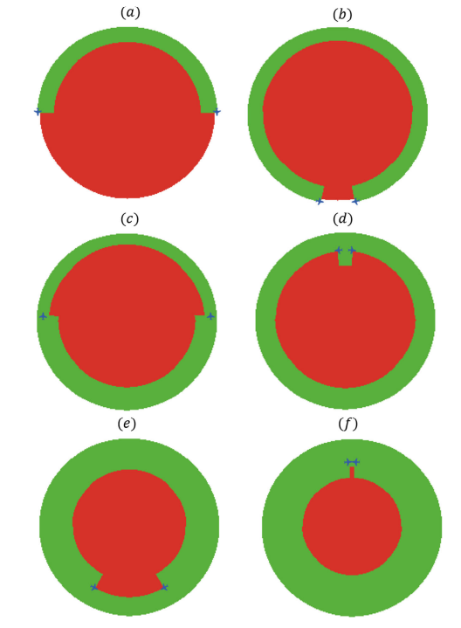
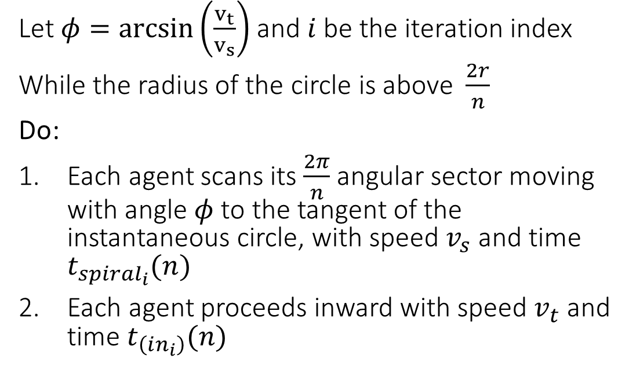
Running of the algorithm
Let $φ=arcsin\left(\frac{v_{t}}{v_{s}}\right)$ and $i$ be the iteration index
While the radius of the circle is above $\frac{2r}{n}$
Do:
Each agent scans its $\frac{2π}{n}$ angular sector moving with angle $φ$ to the tangent of the instantaneous circle, with speed $v_{s}$and time $t_{spiral_{i}}(n)$
Each agent proceeds inward with speed $v_{t}$and time $t_{\left(in_{i}\right)}(n)$

Slide 25
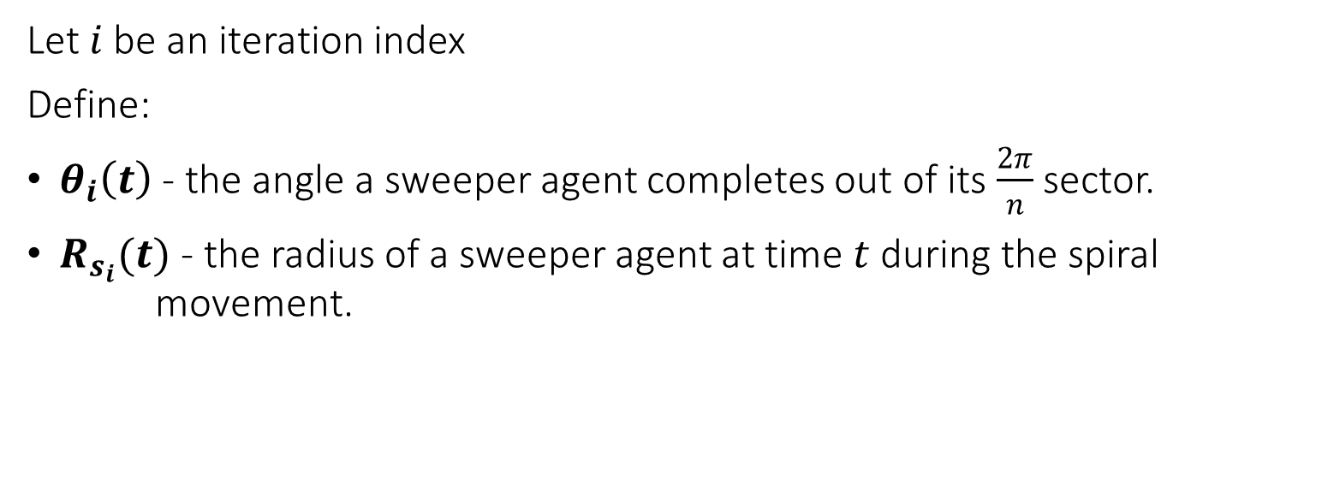
Definitions
Let $i$ be an iteration index
Define:
$θ_{i}\left(t\right)$ - the angle a sweeper agent completes out of its $\frac{2π}{n}$ sector.
$R_{s_{i}}(t)$ - the radius of a sweeper agent at time $t$ during the spiral movement.

Slide 26
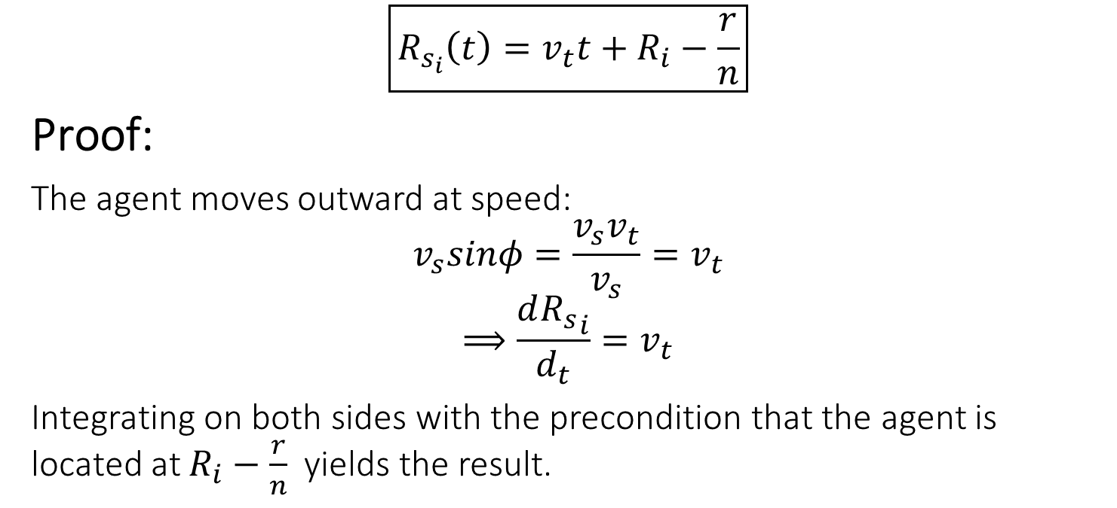
Lemma 1
$$\boxed{R_{s_{i}}\left(t\right)=v_{t}t+R_{i}−\frac{r}{n}}$$
Proof:
The agent moves outward at speed:
$$v_{s}sinφ=\frac{v_{s}v_{t}}{v_{s}}=v_{t}$$
$$⟹\frac{d{R_{s}}_{i}}{d_{t}}=v_{t}$$
Integrating on both sides with the precondition that the agent is located at $R_{i}−\frac{r}{n}$ yields the result.

Slide 27
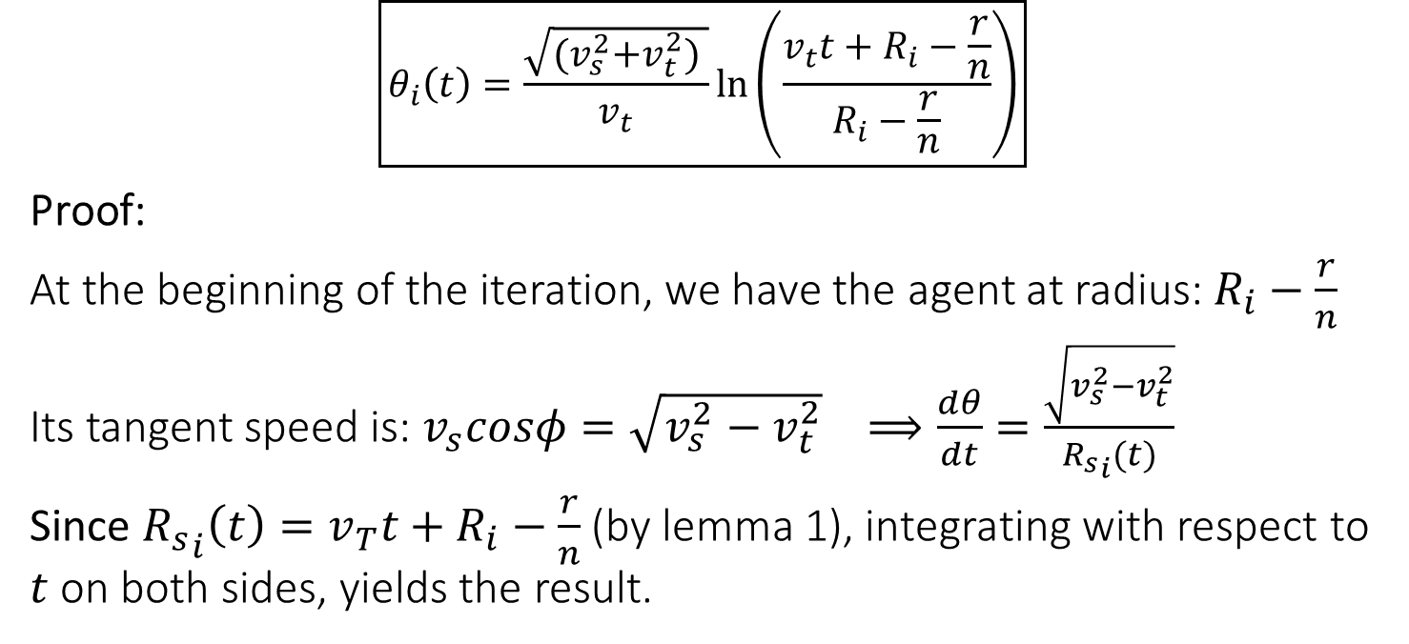
Theorem 1
$$\boxed{θ_{i}\left(t\right)=\frac{\sqrt{{(v}_{s}^{2}+v_{t}^{2}) }}{v_{t}}\ln\left(\frac{v_{t}t+R_{i}−\frac{r}{n}}{R_{i}−\frac{r}{n}}\right)}$$
Proof:
At the beginning of the iteration, we have the agent at radius: $R_{i}−\frac{r}{n}$
Its tangent speed is: $v_{s}cosφ=\sqrt{v_{s}^{2}−v_{t}^{2}} ⟹\frac{dθ}{dt}=\frac{\sqrt{v_{s}^{2}−v_{t}^{2}}}{{R_{s}}_{i}(t)}$
Since ${R_{s}}_{i}\left(t\right)=v_{T}t+R_{i}−\frac{r}{n}$ (by lemma 1), integrating with respect to $t$ on both sides, yields the result.

Slide 28
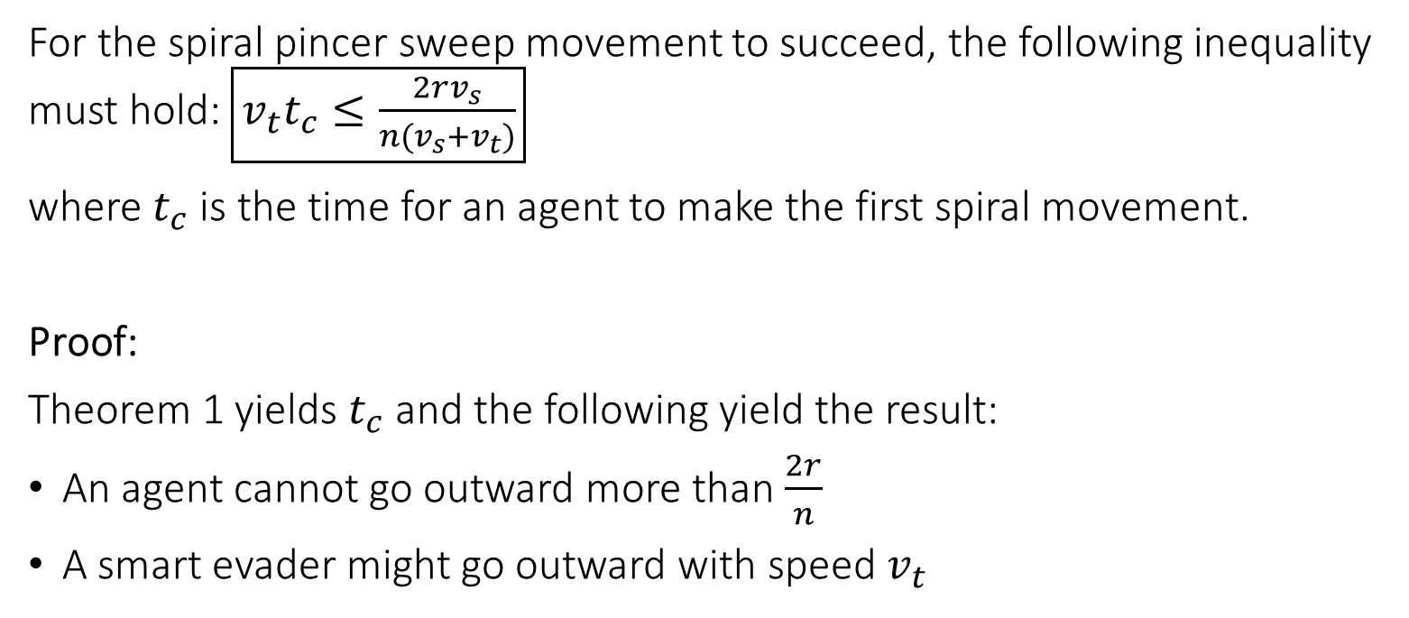
Lemma 2
For the spiral pincer sweep movement to succeed, the following inequality must hold: $\boxed{v_{t}t_{c}≤\frac{2rv_{s}}{n(v_{s}+v_{t})}}$
where $t_{c}$ is the time for an agent to make the first spiral movement.
Proof:
Theorem 1 yields $t_{c}$ and the following yield the result:
An agent cannot go outward more than $\frac{2r}{n}$
A smart evader might go outward with speed $v_{t}$

Slide 29
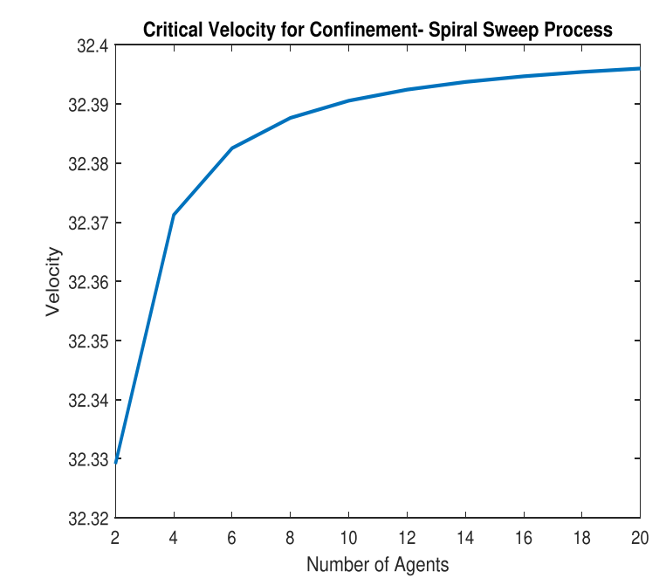
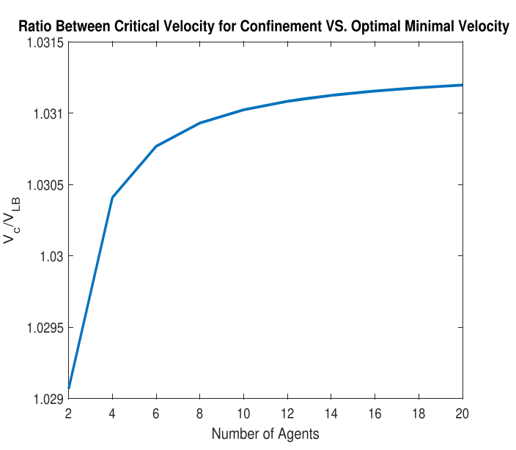
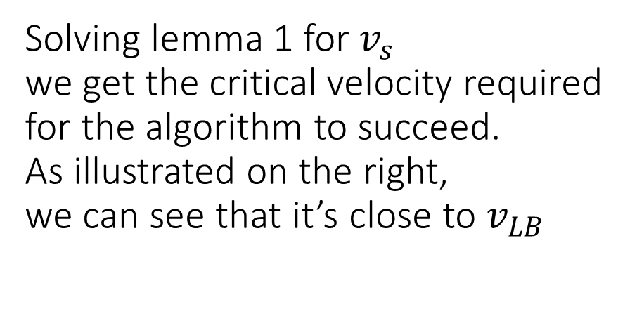
Solving lemma 1 for$v_{s}$ we get the critical velocity required for the algorithm to succeed. As illustrated on the right, we can see that it’s close to $v_{LB}$

Slide 30
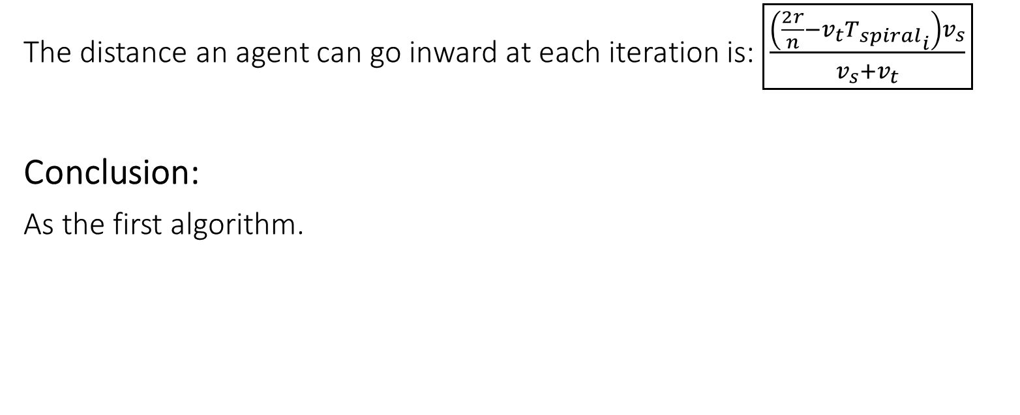
Lemma 3
The distance an agent can go inward at each iteration is: $\boxed{\frac{\left(\frac{2r}{n}−v_{t}{T_{spiral}}_{i}\right)v_{s}}{v_{s}+v_{t}}}$
Conclusion:
As the first algorithm.

Slide 31
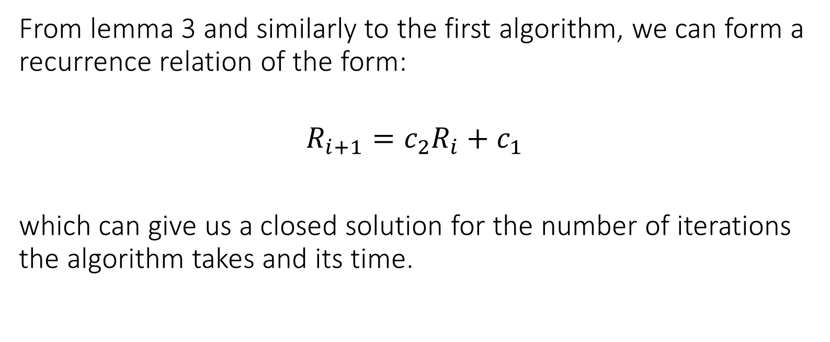
From lemma 3 and similarly to the first algorithm, we can form a recurrence relation of the form:
$$R_{i+1}=c_{2}R_{i}+c_{1}$$
which can give us a closed solution for the number of iterations the algorithm takes and its time.

Slide 32

Simulation

Slide 33
References
All is based and studied from the paper:
“Search for Smart Evaders with Swarms of Sweeping Agents- a Resource Allocation Perspective”
by Roee M. Francos and Alfred M. Bruckstein (2022)

Slide 34
Thanks
We would like to thank Freddy Bruckstein and Dave Dovrat for a fascinating course.
Also, we thank Roee Francos for helping us out preparing for the presentation.

